Slide 1
Blast Basic Local Alignment Search Tool

Slide 2
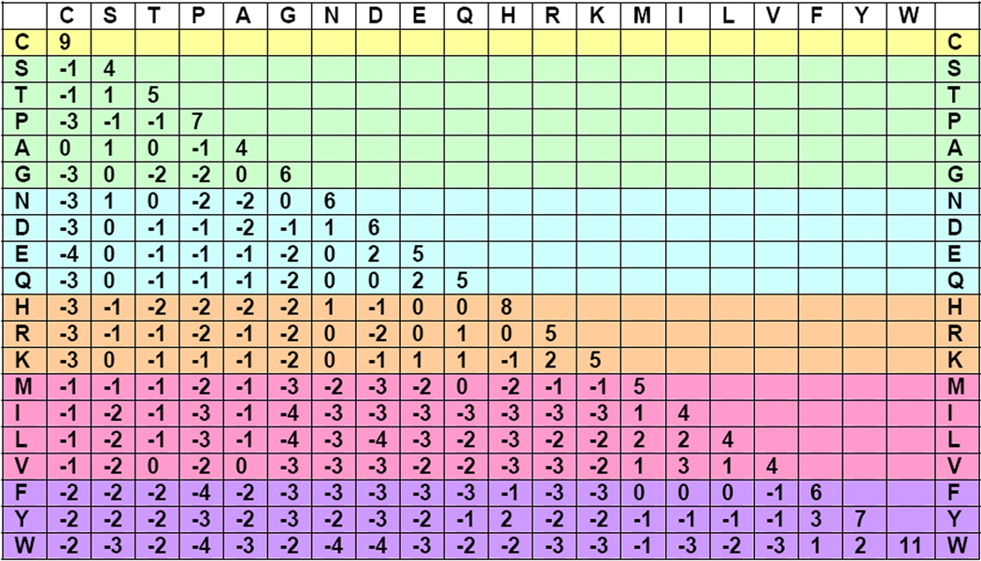
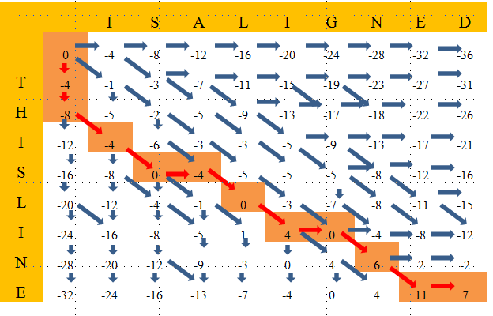
Recap : Pairwise sequence alignment
Grouping of two sequences to maximize similarity/identity using a scoring system (substitution matrices):
PAM (1,120,250)
BLOSUM (80,62,45)
Optimal alignment algorithms:
Global and local
Evaluation of significance
T H I S S E Q U E N C E
| | | | | | | | | |
T H A T S E Q U E N C E

Slide 3
Pairwise alignments are computationally inefficient for database searches
People want to compare sequences against databases
NW or SW algorithms do not scale well
Run time is proportional to product of lenghts
Query humanRBP4 , 185 aa
Target: Human beta-lactoglobulin, 179 aa
NW will take 2 s
Looking in complete human genome (30,000 genes) will take 6 x10⁴ sec = 16 hours
Solution = use heuristics programs
Work well most of the time, rule of thumb
Not all comparisons are needed

Slide 4
Best Local Alignment Search Tools
A family of tools used to quickly find related sequences
Heuristic approach: works well most of the time
Finds high scoring pairs (HSPs): Local alignments with scores above a certain threshold
Steps:
Chose your sequence (query)
Select blast program
Select database to search
Choose optional parameters

Slide 5
Blast flavors
Program | Query (What you are looking for) | Number of database searches | Database (Where are you looking for)
blastp | Protein | 1 | Protein
blastn | DNA | 1 | DNA
blastx | DNA | 6 | Protein
tblastn | Protein | 6 | DNA
tblastx | DNA | 36 | DNA
Prefix t = DNA database is translated into six proteins
Suffix x = DNA query is translated into six proteins

Slide 6
Blast algorithm
The main idea behind BLAST:
“... to confine attention to segment pairs that contain a word pair of length w with a score of at least T.” Altschul et al. (1990)
List
Compile a list of word of size w above a threshold T
Scan
Scanning the database entries that matched the compiled list
Extend
Extend the hits in either direction, stop when scores drop below a threshold

Slide 7
1. Create a list of words
- Convert sequences into words of length n (n=3 proteins, n=11)
Keep words that will can create an ungapped alignment score more than the threshold T using a substitution matrix (default T=11, BLOSUM62)
VLSPADKTNVKAAWGKVGAHAGEYGAEALERMF
VLS
LSP
SPA
PAD
ADK
DKT
…
P A D P A D P A D P A D
P A G P A R P G D P A D
7 4 -1 7 4 -2 7 0 6 7 4 6
Score 10 9 13 17

Slide 8
2. Possible matches are searched in database
Database
Locate matches ( )
Find matches that are in the same diagonal within a given distance (40 residues)
Query

Slide 9
3. Extend alignments
Database
Extend alignments using a gapped algorithm and stop if score goes below S treshold (S depend on database)
Query

Slide 10
4. Join alignments and analyzed best one
Database
Join alignments if score of the joined alignment is better than individual ones
Create score and report matches whose expect score is lower than a threshold parameter E
Query

Slide 11
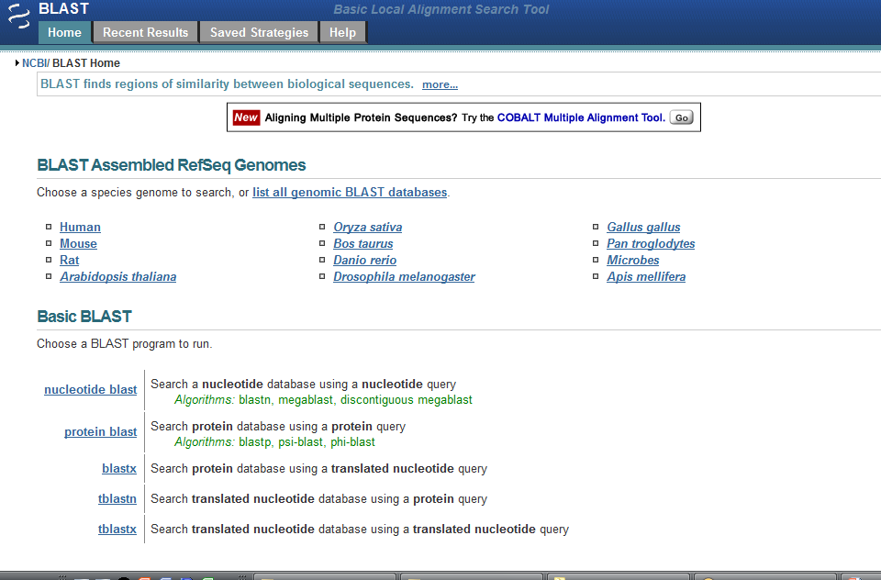
Use genomes as databases
Search NCBI databases

Slide 12
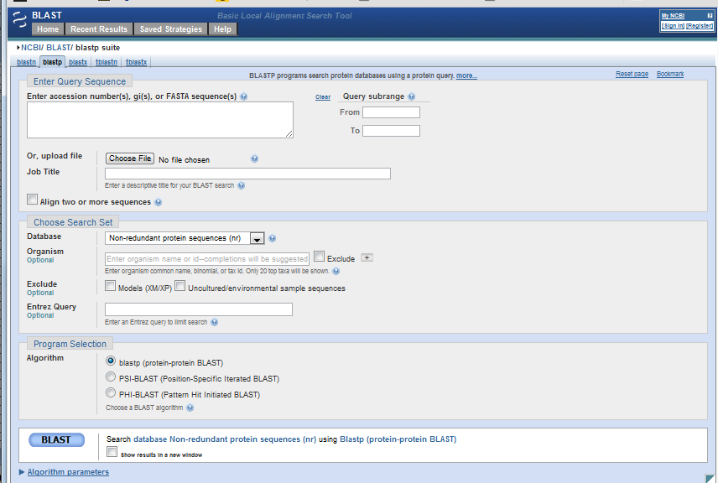
Enter query
Select database
Select program and parameters
Modify search parameters

Slide 13
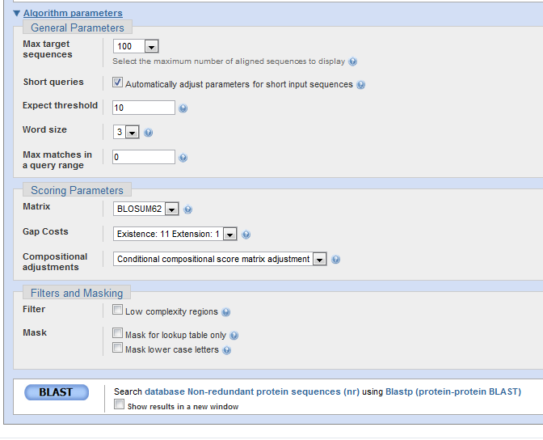

Slide 14
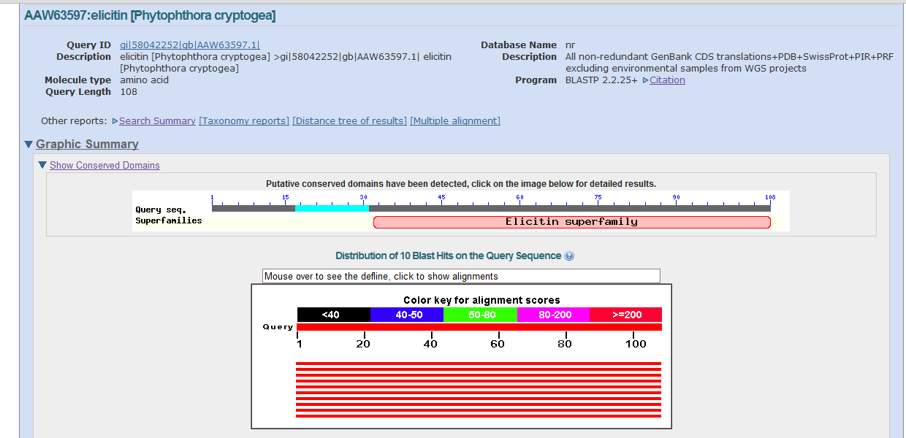
BLAST results I Graphic summary

Slide 15
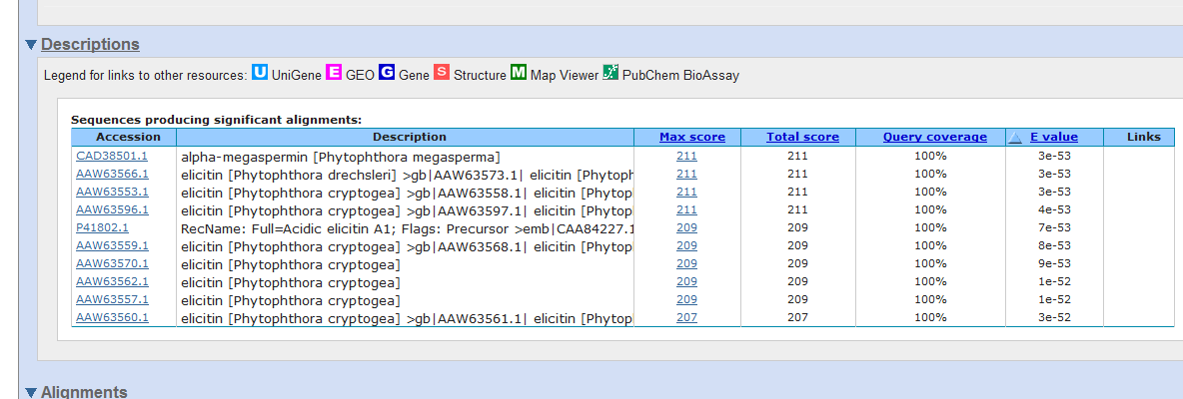
BLAST results II
Description of hits and alignment scores

Slide 16
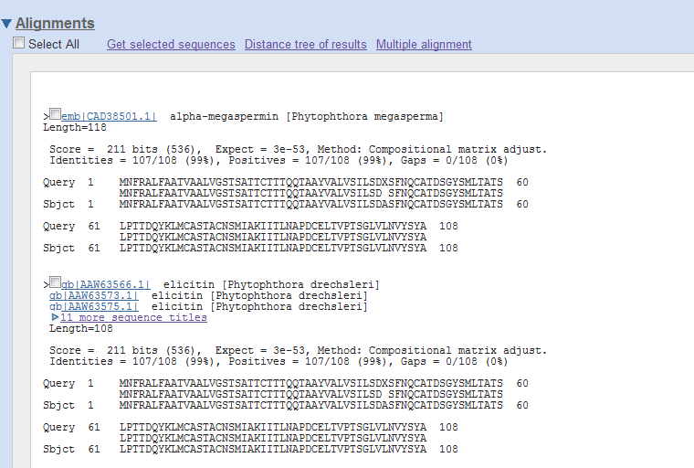
BLAST results III
Local alignment details

Slide 17
Local alignment search statistics
BLAST use
The extreme value distribution to approximate the significance of scores found in a search against a database.
Given a score S
We can calculate the number of entries in a search of a random query against a random database that is expected to have a score equal or higher than S.
Expect value
The number of HSPs expected to have a particular similarity score given the random query-random database model.
E = 1, one match expected randomly.
E = 1e-10, one match out of 1e10 sequences expected randomly.

Slide 18
From probability function to Expect value
P(S<x) = exp(-e^{-λ(x-u)})
0.40
0.35
0.30
0.25
probability
0.20
0.15
0.10
0.05
0
-5
-4
-3
-2
-1
0
1
2
3
4
5
x

Slide 19
From probability function to Expect value
P(S<x) = exp(-e^{-λ(x-u)})
The probability that the alignment score, S, is smaller than x
For ungapped alignments, u = ln(Kmn)/λ
K: a scaling factor, depends on scoring matrix
m: size of query
n: size of database
P(S<x) = exp(-Kmne^{-λx})
P(S ≥ x) = 1 - P(S<x) = 1 - exp(-Kmne^{-λx})
The probability that an HSP has a score S equal to or better than x by chance
Expect value: E = Kmne^{-λS}
Number of HSPs with a score S expected randomly
λ, K: Karlin-Altschul statistics, depend on scoring matrix

Slide 20
Properties of E value
E = Kmne^{-λS}
The value of E decreases exponentially with increasing S
Higher S values correspond to alignments that are more likely to be non-random
E = 1
One match with the same score is expected to occur by chance
Size of database influence E value
Can’t really compare the E value between queries against different databases because most of the time you don’t remember what n is.
The scoring matrix affect S, therefore affect E value as well
The second reason why E values between searches may not be comparable

Slide 21
Effects of E value threshold
Larger E value results in more hits but most of them are likely not real
Expect | 1 (T=11) | 10 (T=11) | 10,000 (T=11)
#hits to db | 1.3e8 | 1.3e8 | 1.3e8
#sequences | 1e6 | 1e6 | 1e6
#extensions | 5.2e6 | 5.2e6 | 5.2e6
#successful extensions | 8,367 | 8,367 | 8,367
#sequences better than E | 86 | 142 | 6,439
#HSPs>E (no gapping) | 46 | 53 | 6,099
#HSPs gapped | 88 | 145 | 6,609

Slide 22
Relationships between E value and P(S ≥ x)
As E value decrease, p value decrease as well
But what’s the effect of database size? Why are we concerned about this?
E p
10 0.99995460
5 0.99326205
2 0.86466472
1 0.63212056
0.1 0.09516258 (about 0.1)
0.05 0.04877058 (about 0.05)
0.001 0.00099950 (about 0.001)
0.0001 0.0001000

Slide 23
Bit scores, why this is useful
E value... not comparable between searches.
Raw score
Calculated from a substitution matrix
Raw scores sometimes are not comparable between searches due to the use of different scoring matrix.
Bit score
Comparable between different searches because they are normalized to account for the use of different scoring matrices and different database sizes
Define as: S’ = (λS - lnK) / ln2
Relationships between E value and S’
E = mn*2 ^{-S’}

Slide 24
Summary BLAST
Fast way to find related sequences using local alignments
Widely adopted
Provides some estimation of goodness of matches
Can be run locally
Database dependent, non-redundant database is biased to human-important sequences
Does not necessarily finds best matches
Similarity is based on local alignment

Slide 25
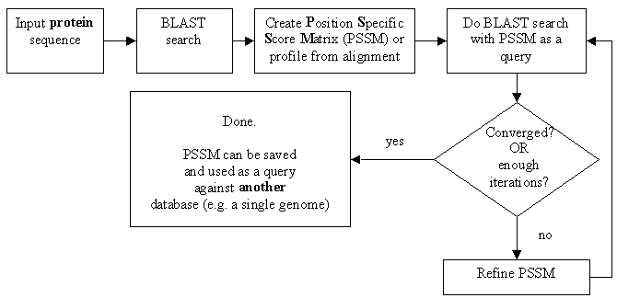
PSI-BLAST
Background: Number of matches depends on substitution matrix
Solution: use customized scoring matrix to find more relatives of sequence
PSI= Position -Specific Iterated
Modified from :http://web.uconn.edu/gogarten/bioinf/TOPIC2.HTM

Slide 26
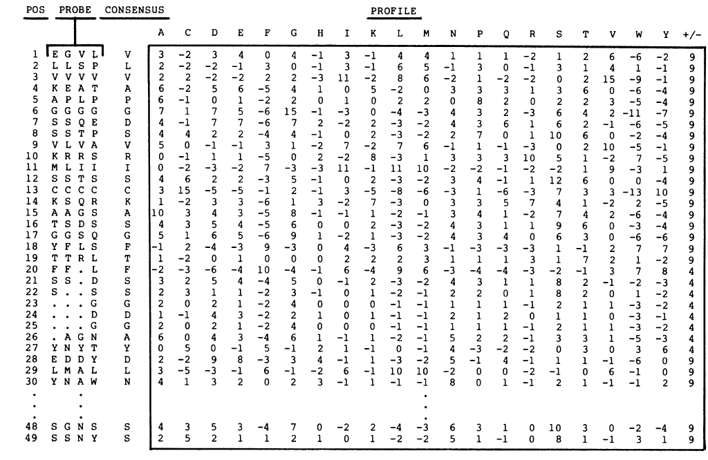
Position specific scoring matrices gives more weight to conserved regions than standard substitution matrices
From Gribskov, 1989. Profile analysis: detection of distantly related proteins. PNAS. 84(13): 4355–4358

Slide 27
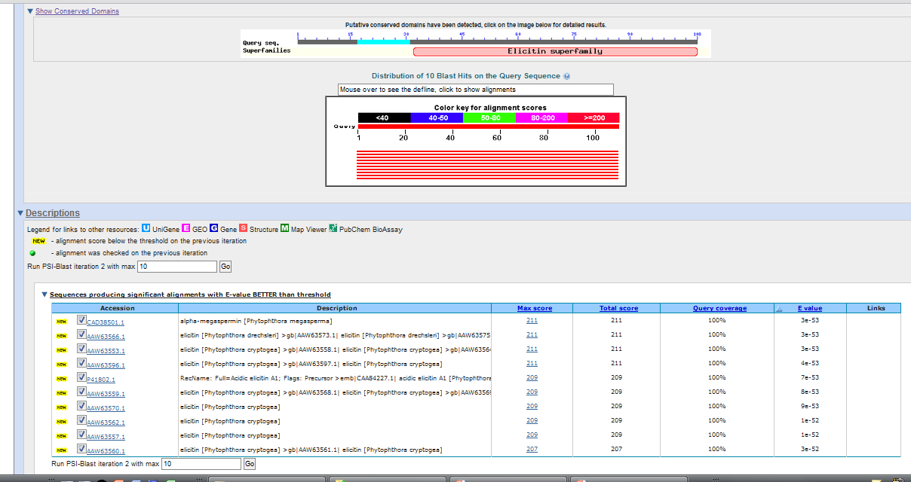
PSI-BLAST results
Run next iteration with the selected newly found sequences

Slide 28
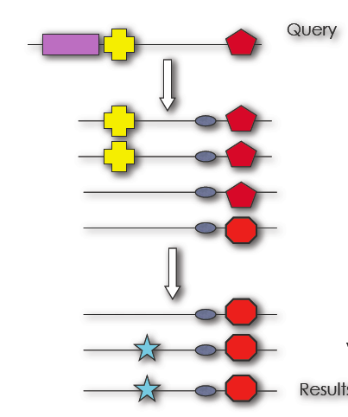
Conclusion PSI-BLAST
Quick
Increased sensitivity for detecting distantly related proteins
Depends on how good the PSSM is:
If non-homologous matches are included into model, search gets worse over time
Image from :
http://www.infection.bham.ac.uk/Teaching/Bioinformatics_BSc/PSI-BLAST/PSI-BLAST.pdf

Slide 29
Running Blast (and PSI Blast) locally
Run in the local computer
Own desktop
Remote server you control
Access to all Blast tools
Can be used with a customized database
Will not run out of time
Easily parallelizable
More control on search parameters
Customized result outputs

Slide 30
Running Blast locally
Download executables
Install (e.g install in c:/b/
Format database:
> makeblastdb.exe –in <db.file.fasta> -dbtype <nucl or prot>
4. Select program:
5. Select query and run with parameters needed
>blastp.exe -query <query.fast> -db <database name>

Slide 31
BLASTP options
Argument | For | Example
-database | Database | atpepdb
-query | Query sequence file | query.fa
-evalue | Expect value threshold | 10 (default)
-out | BLAST output file name | query_vs_atpepdb.out
-gapopen | Gap opening penalty | -11 (default)
-gapextend | Gap extension penalty | -1 (default)
-num_descriptions | # of matches with descriptions | 500 (default)
-num_alignments | # of matches with alignments | 250 (default)
-threshold | Minimum word score that the word is added to the BLAST lookupt | 11 (default)
-matrix | Substitution matrix | BLOSUM62 (default)
-word_size | Word size | 3 (default)
-outfmt | Formatting output | 10 (.csv)

Slide 32
Parameters of blastall (~/bin/blast/bin/blastall)
Arg. | For | Example
-p | Program name | blastp
-d | Database | atpepdb
-i | Query sequence file | query.fa
-e | Expect value threshold | 1e-5
-m | Alignment view options | 0 (default)
-o | BLAST output file name | query_vs_atpepdb.out
-F | Apply low complexity filter | F
-G | Gap opening penalty | -1 (default)
-E | Gap extension penalty | -1 (default)
-v | # of matches with descriptions | 100
-b | # of matches with alignments | 100
-f | Hit extension threshold score | 11 (default)
-M | Substitution matrix | BLOSUM62 (default)
-f | Hit extension threshold score | 11 (default)
-w | Word size | 3 (default)

Slide 33
Summary
Blast is a rapid and heuristic method
Fast results, most of the time good
Local alignment, do not report this similarity
Results depend on search parameters
Databases are biased for human related groups. e.g. Enterics, pathogens.
Blast can be run locally

